Slide 1
Anti-money laundering: how firms are getting on
Zoё Allen-Robinson
AML Proactive Supervision Manager

Slide 2
To cover
The basics
Update on how we supervise
Findings from proactive supervision
Trends in enforcement
Q&A
Notes:
Introduce yourself
Will cover off these points
Then time for questions

Slide 3
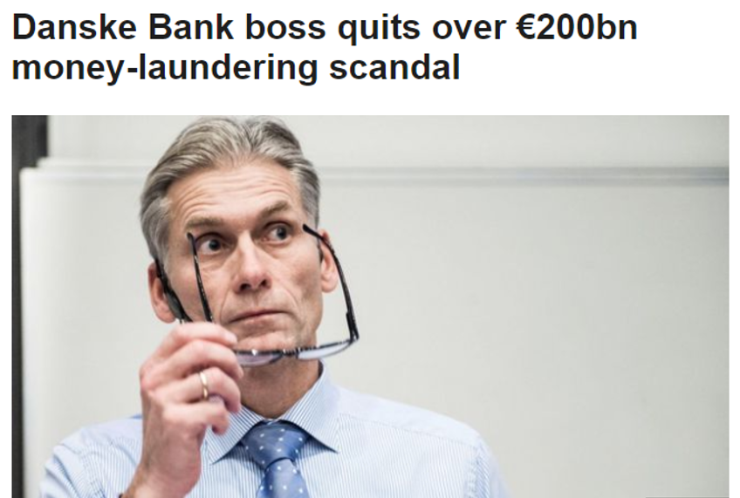
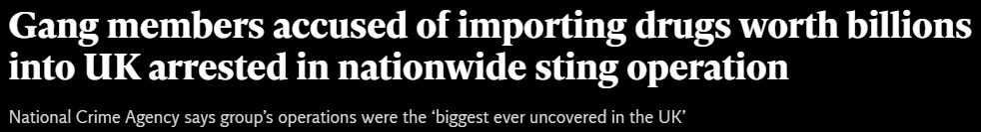
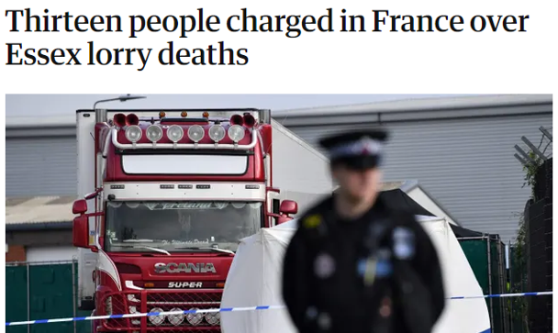

Why do we care?

Slide 4



The legislation
Proceeds of Crime Act
Terrorism Act
Money Laundering Regulations (amended in 2019)
Notes:
Included mainly for completeness – has not appeared so far but is bound too. Funds are usually legitimate and so less need for solicitors to become involved.

Slide 5
Professional body supervision
We are the largest legal services anti-money laundering (AML) supervisor
We are regulated by the Office for Professional Body Anti-Money Laundering Supervision (OPBAS)
OPBAS assesses our AML supervision of those we regulate
Notes:
This is why preventing money laundering should be important to firms.
The title of the presentation you’ve been given is misleading – firms should care less about compliance than doing the right thing

Slide 6
What are the basics to know?
2017 Money Laundering Regulations
Are you in scope? If not, where’s the risk?
Nominate a Money Laundering Compliance Officer (MLCO) and Reporting Officer (MLRO)
Get your beneficial owners, officers and managers approved with the SRA

Slide 7
What are the basics to know?
2017 Money Laundering Regulations
Do your risk assessment at firm level and client/matter level (for each client)
Have proportionate policies, procedures and controls
Train your staff and make training records
Do risk-based customer due diligence and record your decisions

Slide 8
What are the basics to know?
2019 Amendment Regulations
Definition of tax advisers much wider
Report customer due diligence discrepancies to Companies House
Apply EDD where:
  a transaction is complex, unusually large, or unusually patterned
  where links to an EU high risk third country encountered
Verify the senior manager where beneficial owner unsubstantiated

Slide 9
What are the basics to know?
Proceeds of Crime Act 2002
Know the warning signs of money laundering – criminals are using solicitors to add a veneer of trust
Make sure staff know who to tell – make sure you have an internal suspicious activity report process
Report suspicious activity to the National Crime Agency whether you turn the client away or not – this is in the national interest

Slide 10
Last year in numbers…
85 visits to firms
70 desk-based reviews
98 firm-wide risk assessment reviews
273 reports to us about suspected breaches
16 internal sanctions
13 cases brought to the Solicitors Disciplinary Tribunal
Notes:
85 visits total
- 69 rolling programme
- 6 FI visits
- 10 for thematic

Slide 11
Visits
Visited 85 firms during 2020/21
Majority were partially compliant with the regulations
Most common follow-up was letter of engagement which requires corrective action
Notes:
16 compliant
45 partially compliant
8 not compliant
16 Guidance issued
30 letter of engagement (ie some changes needed, but not so widespread as needs a compliance plan)
15 compliance plan
8 referred for investigation and possible sanction

Slide 12
Desk-based reviews
We carried out 168 desk-based reviews in 2020/21
  98 narrower reviews into firm-wide risk assessments
  70 more comprehensive desk-based reviews
Majority partially compliant
Most common next steps were guidance issued or engagement
Notes:
FWRA
38 compliant
50 partially compliant
10 not compliant
38 guidance issued
40 engagement
8 compliance plan
12 referred for investigation
DBRs
20 compliant
29 partially compliant
6 not compliant
25 ongoing
1 pursued for non-cooperation
10 guidabce
22 engagement
7 compliance plan
7 referred for investigation

Slide 13
Processes & controls – findings
55% of policies needed some improvements
Biggest concern was that they weren’t followed
Some were missing essential information or were out of date
Notes:
Deficiencies in policies
Count
Had not been updated to reflect the changes from the 2019 amendment regulations
28
No information on the additional measures, where appropriate, to prevent the use for money laundering or terrorist financing of products and transactions which might favour anonymity
23
No information on high-risk third countries
20
No information on simplified due diligence and if it is permitted
17
No information on the firm’s position on reliance
14
No information on enhanced due diligence requirements
9

Slide 14
Firm-wide risk assessment - findings
Really important tool
Lots of guidance available online
Firms forgetting to assess one or more risk factor (most frequently transaction risk)
Continue to see standard templates
Make sure it covers all services in scope of the regulations
Notes:
Lots of guidance on FWRA
Keep it up to date
Using a template is fine, but tailor it to your firm
Mandatory risk factor
Number of firms omitted from FWRA
Transaction risk: 26 firms
Firms did not sufficiently explore transactional risk, such as how many high value transactions the firms deal with, the typical size and value of a transaction, whether transactions are large or complex, and the type of payments accepted, for example, cash payments or payments from third parties.
Delivery channel risk: 17
Firms did not assess how they deliver their services and whether there is a likelihood that this risk changed due to Covid-19. It was difficult to determine from the risk assessments reviewed whether firms meet their clients, if they offer services that are non-face to face, and if they do, how they deliver those services, for example, by email or video meetings.
Geographical risk:12
There was a lack of detail on where the firm’s clients and transactions are based and if any of the firm’s clients have overseas connections. Most risk assessments focused only on setting out the likelihood of dealing with a client from a high-risk jurisdiction and failed to address the geographical locations the firm do deal with and if these are local or national.
Client risk: 7
Firms failed to set out the type of clients they deal with. For example, whether these clients are individual or companies, if any of the companies have complex structures, whether the clients are predominantly new or long-standing clients, if any clients pose a higher risk such as politically exposed persons.
Products and service risk: 6
Many firms are failing to list all the services they provide that are within scope of the regulations. A cross check against the firm’s website and information we gather during our practising certificate renewal exercise shows a disconnect between the FWRA and the products and services provided.

Slide 15
Audit – findings
Number of firms with issues remains high
Must be undertaken where ‘relevant to size and nature of the firm’
49 out of 69 firms visited had recommendations around audit
Independent doesn’t need to mean external
Notes:
Reviews had been carried out but they were insufficiently robust or were not formalised15
Failure to examine and evaluate the effectiveness of the firm’s policies, controls and procedures (lacked an element of testing via file reviews)10
Failed to examine and evaluate the adequacy of the firm’s policies, controls and procedures (lacked a thorough review of the policies against the requirements and firm needs)5
Lacked independence (carried out by persons involved in the creation of the policies)3

Slide 16
Employee screening – findings
49 out of 69 firms received feedback on screening
Progress on assessment of existing employees’ skills and experience
Issues with assessing conduct and integrity on an ongoing basis
Notes:
34 out of the 42 firms were carrying out appraisals
28 out of the 42 firms were carrying out file reviews.
DBS checks for example, a number are including DBS checks both on appointment (51 firms) and for existing staff (38 firms).
Good practice
Using multiple methods of screening to ensure that a firm knows as much about its fee earners as possible.
Seeing screening as an ongoing process, not a one-time check at the point of employment.
Relying on independent sources, rather than personal knowledge of the fee earner.
Adopting a holistic approach to screening, embracing existing measures such as annual appraisals, and checking referees
Areas for improvement
Reliance on fee earner declarations alone. MLCOs should consider the risk posed to the firm should a false or incorrect declaration be made.
MLCOs' unfamiliarity with screening processes is a risk for them and their firms. MLCOs have the responsibility of maintaining the firm's compliance with the regulations, which includes screening.
Firms limiting screening to conveyancing staff, in accordance with accreditation schemes, may also pose a risk. Conveyancing is a highrisk area for money laundering, but it is not the only one.
Reliance on personal knowledge of a person before they commence employment with the firm, with no independent checks.

Slide 17
Customer due diligence – findings
Disconnect from policies
Matter risk assessments
Source of funds
Ongoing monitoring
Notes:
Source of funds – 241 files, 103 didn’t have appropriate sof.
recognize this is really challenging. What are they and where are they required?
LSAG says ‘the funds that are being used to fund the specific transaction in hand’.
R28(11) where necessary.
R(11) as part of ongoing monitoring where necessary
Under R35 for PEPs
Hoped for clarification in regs review, but not mentioned so currently legislation likely to stand for some time
RBA approach really important here, check back to FWRA and matter risk assessment. If it assessed as high you need to be doing SoF checks.
Make sure you include in your policy – nearly a quarter of firms didn’t.
Some good practice we’ve seen here:
Doing early in transaction
Including questions on client care letter
Poor practice
Obtaining records but filed without reading
Making assumptions about client’s general wealth without asking questions about this transaction
Client and matter risk assessments
Main issue, not doing one or not rating the risk – this applied to 33% of files.
Ongoing monitoring
How firms ensure the CDD obtained is still appropriate to the risk level.
Whether the risk level needs changing and if that triggers the need for additional checks.
Whether a reactive process exists if something changes to trigger the need for CDD to be renewed. This could be if the instruction from the client changes, or new information comes to light about those involved in a transaction.
How CDD is kept up to date and renewed if documentation is no longer appropriate or valid.
We saw a mixed picture on ongoing monitoring. We took steps with 16 out of 42 firms on ongoing monitoring.
PCPs
55% of policies needed some steps to be taken
Main issue: PCPs not updated, eg for 2019 amendment regs
Mentioned this previously, but big concern here when PCPs not being followed – saw in around a 3rd of firms
Some issues with omissions, in particular no information on HRTCs, no information on what to do for transactions that might facilitate anonymity
No information on reliance

Slide 18
Enforcement
Increase in reports and investigations
Most common investigation - buying and selling property
Key contributing factors:
  Inadequate supervision or training of fee earners
  Inadequate policies, controls and procedures
  Failure by individuals to follow policies, controls and procedures
Notes:
273 reports in 2020/21 – due to NCA, proactive etc
Specific matter reason
Count
failure to cooperate and comply with a request for information under regulation 66
63
failure to carry out source of funds checks where necessary to do so
38
failure to carry out/complete customer due diligence
32
failure to identify the client
24
failure to have proper AML procedures
19
failure to carry out on-going monitoring
12

Slide 19
Help is available
Risk Outlook, national and sectoral risk assessments
Warning notices
Thematic review findings
Legal sector guidance - sra.org.uk/aml-guidance
Professional Ethics helpline and webchat
Notes:
Lots of firms really trying to do right thing
Appreciate cooperation during covid

