Slide 1
Identifying and dealing with Complaints at first tier
^{Jason Chapman Ombudsman}

Slide 2
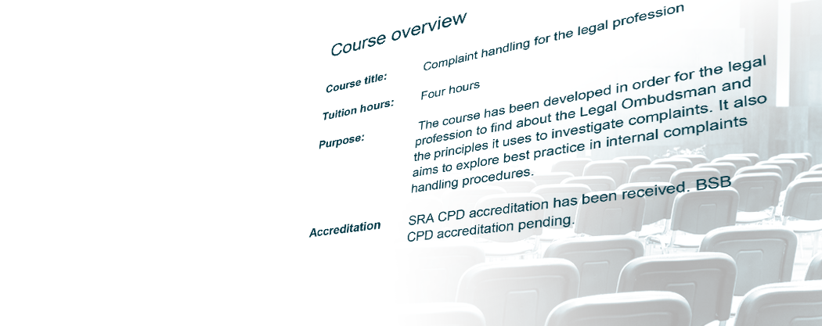
Purpose
Aims:
Share the latest data
In 2020/21, the Legal Ombudsman received 6,246 contacts from customers wanting to complain about their lawyer who had not raised a formal complaint with the service provider first
We have undertaken research to determine why customers come directly to the Legal Ombudsman rather than approaching their service provider first
We want to inform service providers on why customers are not raising complaints with them and tell them,from the findings we have made, what they can do to make it easier for customers to raise issues with them so they can deal with them
Notes:
This number has remained consistent over the past three years. It equates to c. 27% of closed cases.
In September 2021, we commissioned internal research to determine why customers are coming directly to the Legal Ombudsman rather than approaching their service provider first

Slide 3
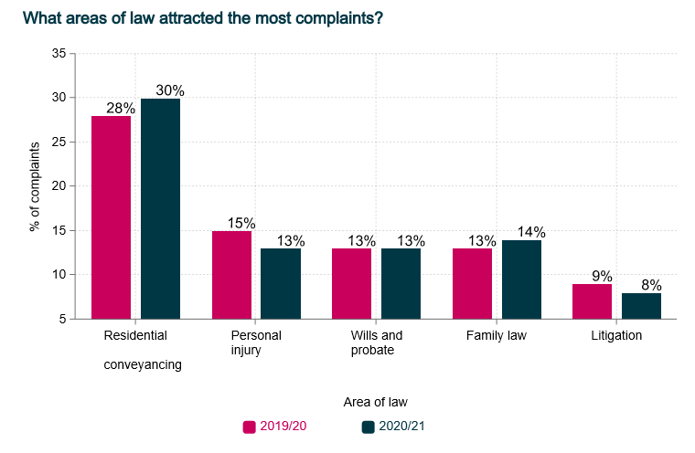
Data
Notes:
In 2020/21 we accepted 4,537 new cases
Unreasonable service found in 55%
Above is the areas of law we receive the most complaints about – consistent for years

Slide 4
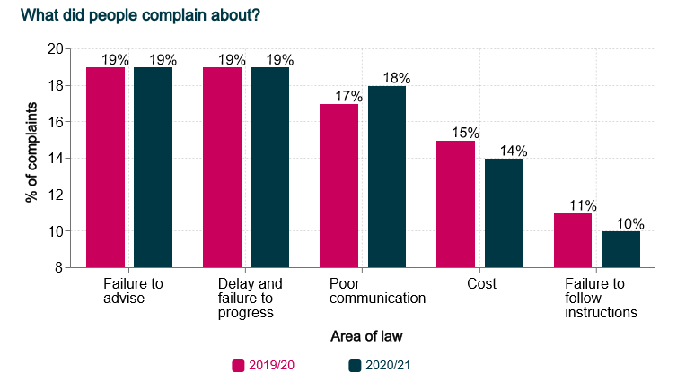
Data
Notes:
Above is what people complained about – again very consistent picture
Outcome:
41% Agreed outcome
36% Ombudsman decision
23% other

Slide 5
Why don’t customers complain
And why do they come directly to the Legal Ombudsman:
Lack of confidence that the service provider would deal with the complaint fairly or were worried that they would withdraw
Lack of awareness of the service provider’s complaints process and that the customer could make a complaint to either a complaints handling partner or a complaints department – poor signposting or lack of information
Lack of understanding about where the Legal Ombudsman fits into the complaints process - 52% of respondents are not told about LeO at any point
Complaining is time consuming
Complaining is unpleasant and customers feel intimidated
Notes:
Complainants often referred to a perceived imbalance of power between them and the service provider
64% of complainants come to the Legal Ombudsman directly whilst their legal matter is ongoing

Slide 6
Lack of confidence
Encourage feedback from your customer and make it clear what they need to do if they want to make a complaint
Learn to spot potential issues and complaints so you can deal with them
Use a complaint as both,
A feedback mechanism, and
An opportunity for learning
Dissatisfied customers tell 15 other people.
70% of people who have a bad experience will warn others not to use the same organisation.
(Institute of Customer Service 2013)

Slide 7
Lack of awareness and understanding
Of the five service providers who had the most premature complaints in 2020/21:
    only one published its complaints procedure online
    two asked customers to contact them if they had a complaint for a call back
    two had no information online regarding how to complain at all
47% of premature complainants contacted the Legal Ombudsman as they did not know how to complain to their service provider
The SRA’s 2018 Transparency Rules require service providers to publish complaints procedures on their website
Notes:
Of the top 20 firms, we found large inconsistencies regarding the amount of and clarity of complaints information online

Slide 8


Lack of awareness and understanding
Make it clear how a customer can raise a complaint if they have cause to do so – have a complaints handling procedure in place and include information in initial client care letter and on website if you have one, including what the customer has to do and who they have to contact
Recognise complaints and potential complaints and address them
The Legal Ombudsman will not accept any complaints for investigation unless the service provider has been given the opportunity to resolve the complaint first
Notes:
Of the top 20 firms, we found large inconsistencies regarding the amount of and clarity of complaints information online

Slide 9
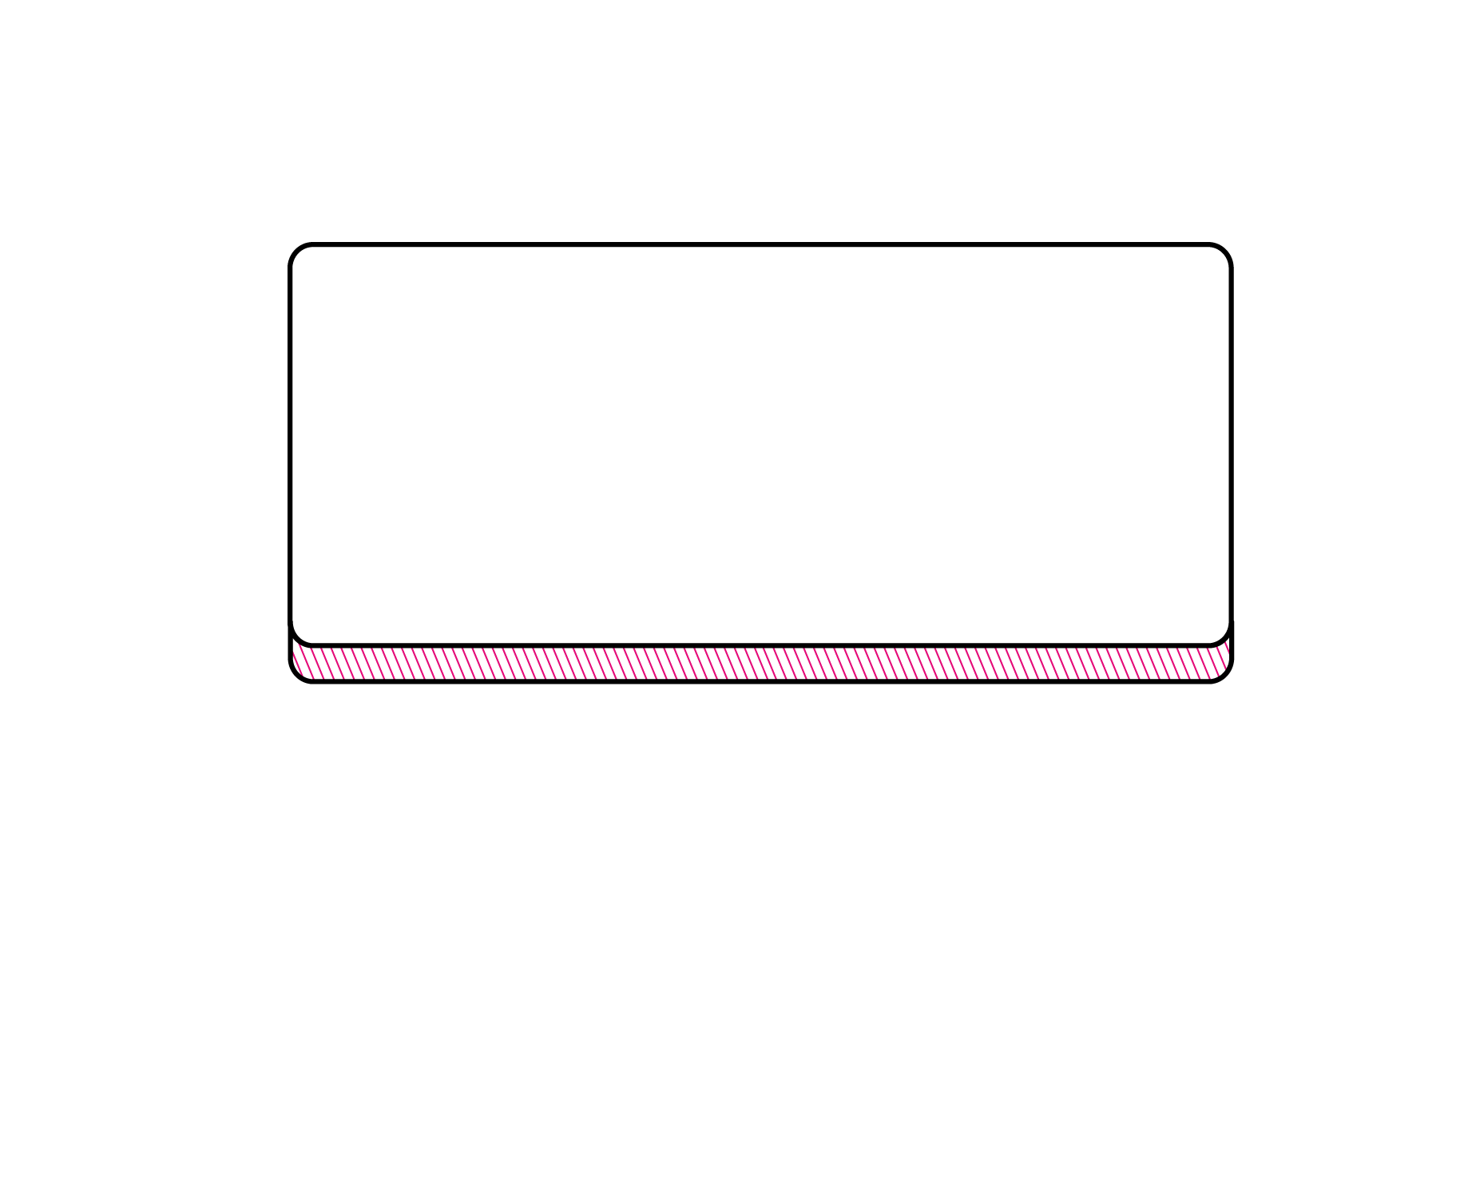
Recognising a complaint
^{Informal}
^{resolution}
^{Formal}
^{process}
^{Response}
“Expression of dissatisfaction”
^{(Scheme rules s. 1.6)}
^{Communication}
^{Raising}
^{queries}
^{Raising}
^{concerns}
Formal complaint letter/email/ phone call
Notes:
If in doubt, treat it as a service complaint and deal with it appropriately in line with your published procedure

Slide 10
Awareness – signposting to LeO
At the beginning:
Include LeO in client care letter and complaints process
At the end:
Ensure LeO contact details and timescales are in your final response* letter:
  Consumer has 6 months** from date of final response to bring the complaint to LeO
  LeO can accept complaints about problems that have arisen in the last 6 years (or if the matter is older than 6 years then the consumer should have become aware of the problem in the last 3 years). (LSB requirements)
  * If you do not hear from the consumer send final response within 8 weeks.
  ** 6 month timescale does not apply if not in the letter
Notes:
We have a signposting guide on our website – please take a look and ensure your signposting is aligned with regulatory requirements

Slide 11
Overview of complaints process
1. Listen
Is a complaint being made?
What are the reasons for the complaint?
2. Inform
Acknowledge and explain the process
Reassure about any worries
4. Learn
Root cause analysis?
Any lessons for staff or firm?
3. Respond
What did you find out?
How will you put things right?
Send final response within 8 weeks and signpost

Slide 12
Feeding back to the profession
  Visit our website for News, Research, Decisions and a dedicated section for service providers
  Courses
  Publications - Thematic reports, guidance and consultations
  LeO news – sign up on our website
  Social media – LinkedIn and Twitter @Legal_Ombudsman
  Technical desk - technical.advice@legalombudsman.org.uk
  What else can we do?
  courses@legalombudsman.org.uk
Notes:
Courses – we will soon have our general complaints handling courses available on our website
Technical advice desk – please get in touch if you want to discuss a complaint informally

Slide 13
Thank you for your time
Notes:
Jason

