Slide 1
The Solicitors Indemnity Fund and post six-year insurance
Chris Handford
Director of Regulatory Policy

Slide 2
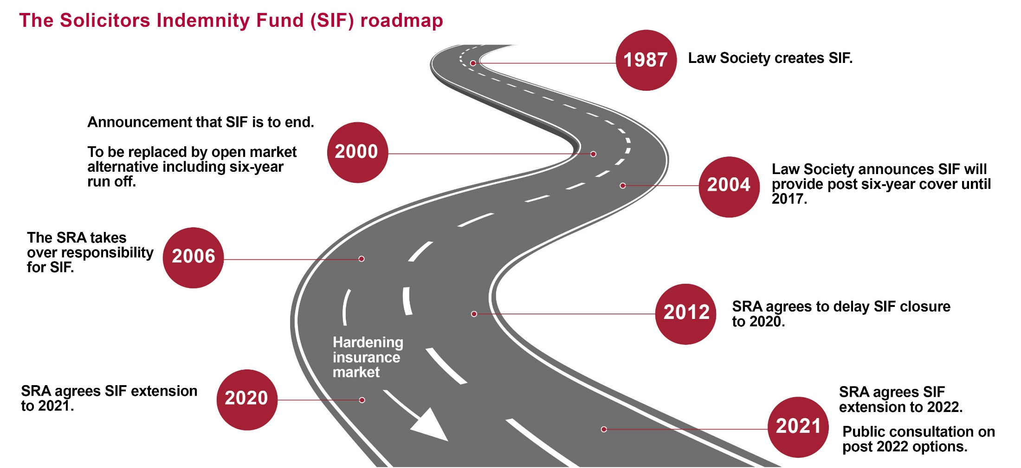
Background

Slide 3


Key issues
Should on-going PSYROC be a regulatory provision?
If so, what would it look like and who would pay for it?

Slide 4





Developing the options
Development of a decision-making framework
Analysis of historic claims data by insurance experts
Analysis of other available data about the characteristics of claimants and the impact of different options
Discussions with other professional services regulators about their run-off requirements
Input from our virtual reference group

Slide 5

Next steps
November
2021
Spring
2022
September
2022
Public consultation opens
Further consultation on any rule changes,
if necessary
(LSB approval required)
Implementation of any changes

