Slide 1
Solicitors Qualifying Examination: what it means for law firms
Benedict Fisher, Director of Communications
Richard Williams, Policy Manager

Slide 2
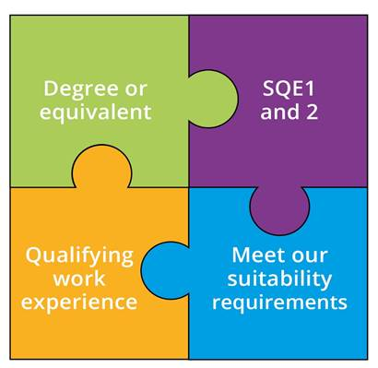
What is the SQE?
Notes:
SQE 2 only after passing SQE 1

Slide 3


Transition
If you have started to train under the LPC route, you have choice to continue, or to switch to SQE.
In general, last QLD/CPE programmes start autumn 2021. Then, everyone must take SQE
Details are complex - check them out on our website!
sra.org.uk/transitional-arrangements

Slide 4





SQE1
Functioning Legal Knowledge
Two 180-question examinations - 10 hours in total
FLK - test ability to identify legal principles and apply them to client problems
and transactions
Unflagged ethics questions throughout

Slide 5
SQE1
Functioning Legal Knowledge
FLK1
FLK2
Business Law and Practice
Dispute Resolution
Contract
Tort
Legal System of England and
Wales
Public Law
Legal Services
Property Law and Practice
Wills and Admin of Estates
Solicitors Accounts
Land Law
Trust
Criminal Law and Practice

Slide 6




SQE2
Practical legal skills assessments
+
16 written and oral tests - 14 hours in total
Simulating tasks carried out by
a solicitor in practice
Tests practical legal skills and functioning legal knowledge equally
Unflagged ethics questions throughout

Slide 7


SQE2
Practical legal skills assessments
Six skills assessed
    Client interviewing and attendance note
    Advocacy
    Case and matter analysis
    Legal research
    Legal writing
    Legal drafting
Across five contexts
Criminal Litigation
Dispute Resolution
Property Practice
Wills and Intestacy, Probate
Administration and Practice
Business organisation rules and procedures

Slide 8




Training and recruitment
Funding through apprenticeships
Tailor training to meet your business needs
Better information to recruit staff
Better guarantee of standards

Slide 9




What is QWE?
Any experience of providing legal services enables an individual to develop some or all of the competences outlined in the Statement of Solicitor Competence
Can be done in England or Wales or overseas – does not have to be in an organisation we regulate
Must be at least two years working full time or the equivalent on a part time basis
Can be done in up to four separate organisations providing legal services

Slide 10




Benefits of QWE for firms
Flexibility in qualification
Practical exposure to competencies required to be a solicitors and assessed in SQE
Opportunities to offer QWE
Training & development aligned to your business

Slide 11


Confirming QWE
A solicitor or COLP (who we regulate) within the organisation where the work experience took place
A solicitor working outside the organisation where the experience took place who has direct experience of work
        Reviewed their work during the relevant period
        Received feedback from supervisor

Slide 12




What is confirmed
Exposure to some or all of the competences – but solicitor is not confirming whether individual is competent
The length of work experience/placement carried out
Whether or not there are character and suitability issues
Should be confirmed if it meets our criteria

Slide 13
Things to consider
How will confirming QWE work if or when you are approached by a candidate:
      Who will it be? How they check?
How will you manage retrospective claims?
      Are you keeping records, for example, are you recording the details of temporary employees and the work they carried out?
      What will recording QWE look like in your firm?
How will you manage employee expectations around QWE and qualification?
Can you take advantage of flexibility to support your recruitment?

Slide 14




What does good QWE look like
Diverse and varied work that provides exposure to a wide range of competences
Opportunities for reflection on performance to identify both strengths and areas of development
Exposure to professionalism and to ethical issues
Effective supervision throughout the placement

Slide 15




Further resources
SQE assessment:
sqe.sra.org.uk
Wider qualification info: sra.org.uk/sqe
SQE webinars:
youtube.com/SRAsolicitors
Subscribe to SQE Update
newsletter: sra.org.uk/sqeupdate

